Slide 1









Neural
Neatworks
From Chaos to Clarity:
An LLM-Ride
Diego Andrino
Jan Greve
Sourav Adhikari
Benedek Szeli

Slide 2
Agenda
Neural Neatworks
Part 1: Status Quo
Part 2: Why LLM?
Part 3: Assumptions and Explanation of Our Approach
Part 4: Results
Part 5: Future Outlook

Slide 3


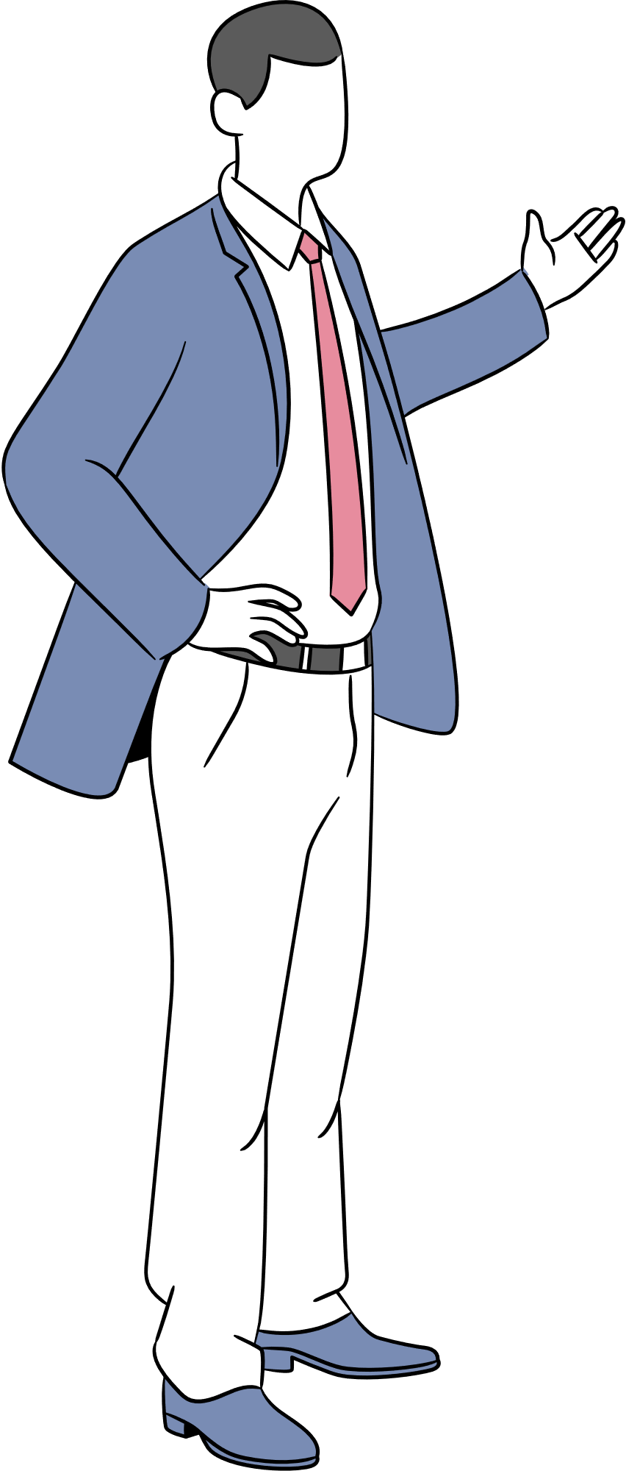


UNIDO board meeting before the arrival of the Japanese delegation . . .
We should reclassify our
project portfolio to
keep donors and
to show our impact
But we have thousands
of projects, it would take
years to read and classify them!
What if we
used LLM . . .

Slide 4
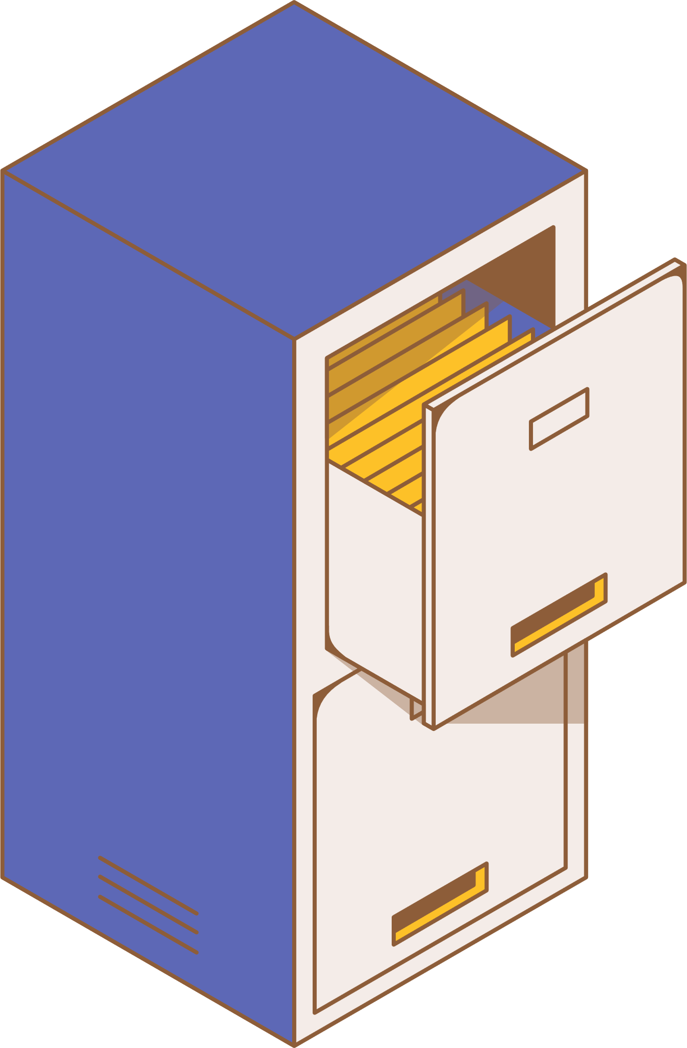


Status Quo
Imagine a drawer filled with random notes on different subjects —
some about cooking, others about travel, gardening, etc.
In the current state, the project documents are in this drawer,
containing words and phrases associated with different themes...

Slide 5


Status Quo
Project documents are being classified and analyzed manually
This prevents generalization, is tiresome and leads to lack of a big picture
Automating the classification process aids in better generalization, quicker information retrieval, improves scope and scale

Slide 6


What is LLM?
Imagine you have an incredibly smart robot friend named Robo. It can understand and talk to you in a way that feels totally human! How?
Well, it's all thanks to Robo reading millions of books beforehand.
When Robo is created using computer code and the magic of NVIDIA GPUs, it's called a Large Language Model (LLM)

Slide 7

Why LLM?
25
according to our estimations, this is the average
number of pages of a UNIDO project report.
To make order in the projects, many hours of intense labor
would be needed, involving thousands of documents.
Using LLMs (Llama 2 in this case), categorization
can be streamlined and executed with ease.
The only things needed are good prompts and GOOD DATA

Slide 8



Assumptions
Given the hackathon’s time frame, we assumed it would be wiser to create a working model on a streamlined dataset
We focused on projects with a single description file: this reduces complexity, size and enables a more straightforward approach
With less (but streamlined) data to process, the LLM models can be tested much faster

Slide 9


Our Approach
The four tiers of our action plan:
Clean the data
Make usable and adaptable prompts
Summarize and visualize results
Note the shortcomings

Slide 10



Data Pre-processing
The data was provided in the form of .json files. Two .json files were joined
(inner-join/intersection) based on each project’s ID.
Out of nearly 600 projects, we excluded the entries which included:
broken URLs
unsupported file formats
corrupt or unreadable files (scanned documents, photographs, low resolution)
After further preprocessing, we were left with 294 projects
on which the final analyses were done

Slide 11

Categories
As a first step to creating order we needed to define the categories
which we want to use:
SDGs: The Sustainable Development Goals are closely connected to the projects of UNIDO and therefore can serve as a base for categorization
UNIDO Priorities: broader categories that serve as the pillars of the organization
UNIDO Focus Areas of Expertise: describes the project’s main characteristics and focus

Slide 12
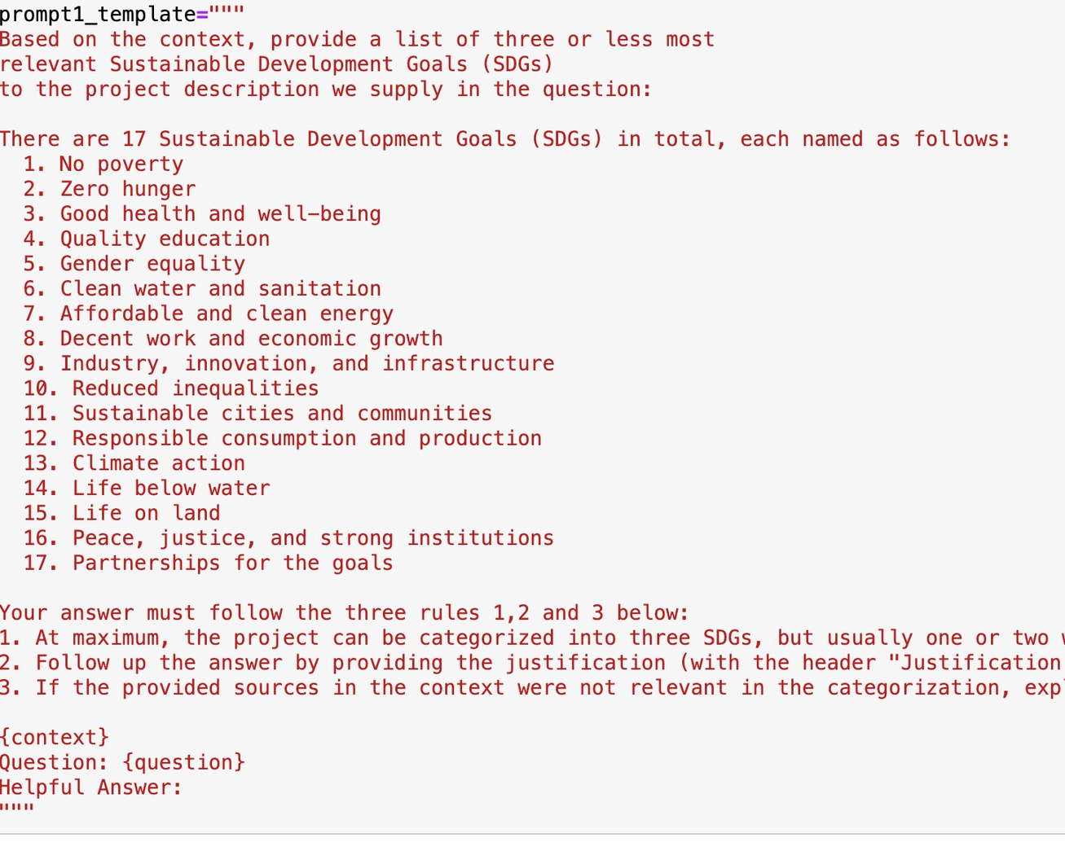
Prompt Engineering
Countless tries & errors
LLM ignoring the max number of categories:
-> Put important instructions first!
LLM making things up:
-> Make it refer to sources as the context
LLM not respecting “should” queries:
-> Tell that it “must” or sometimes “MUST”
LLM less responsive to uncommon words:
-> Replace “Adhere to” with “Follow”, etc.

Slide 13

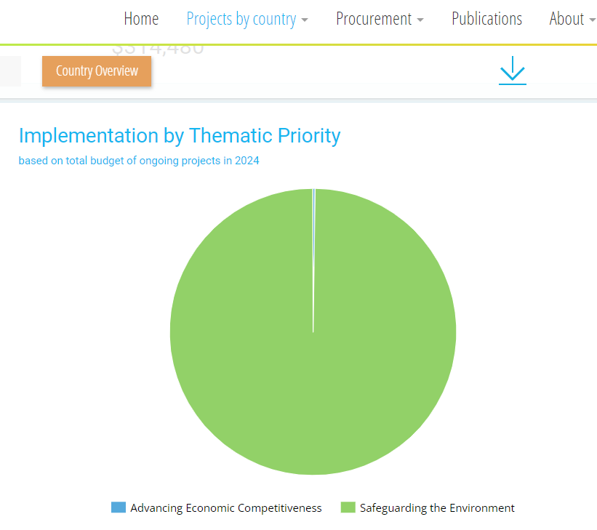
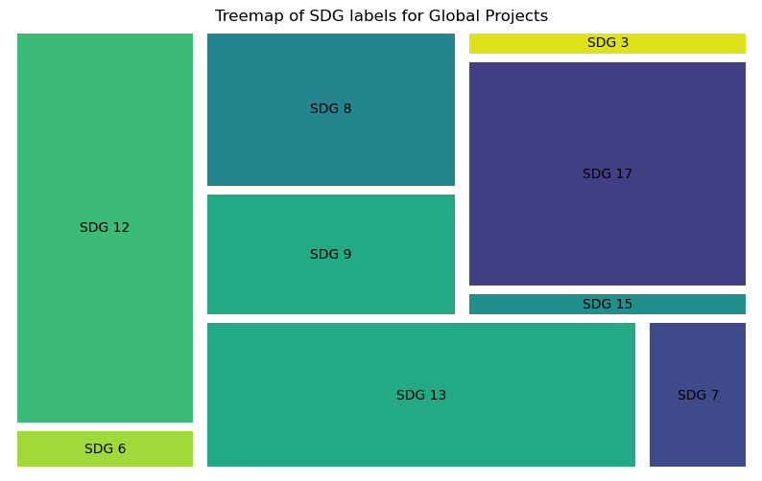
Visualization
UNIDO Open Data Platform in its current state
UNIDO Open Data Platform in the future

Slide 14




Retrieval Augmented Generation (RAG)
Question
Full Prompt
Response
Search for source
Provide source

Slide 15
Why did we use RAG?
Higher Reproducibility: It significantly reduces the randomness in the response by grounding the response to the source
Greater Customisability: The source database can be further enriched using internal documents, written notes/reports by domain experts, etc.
Fault Tolerant: By looking at the sources it returns in addition to the response so that domain experts can asess the quality of the answer

Slide 16

















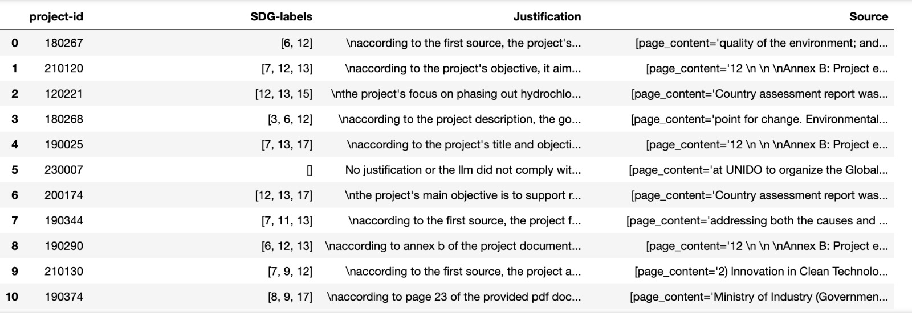
Prompt Outputs
Task 1: Classification of projects into SDG labels:

Slide 17
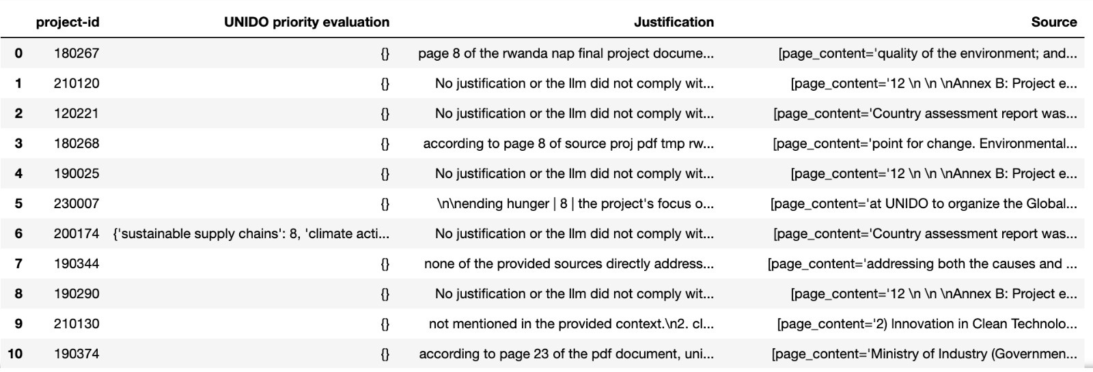
Prompt Outputs
Task 2: Project evaluation based on UNIDO Priorities

Slide 18
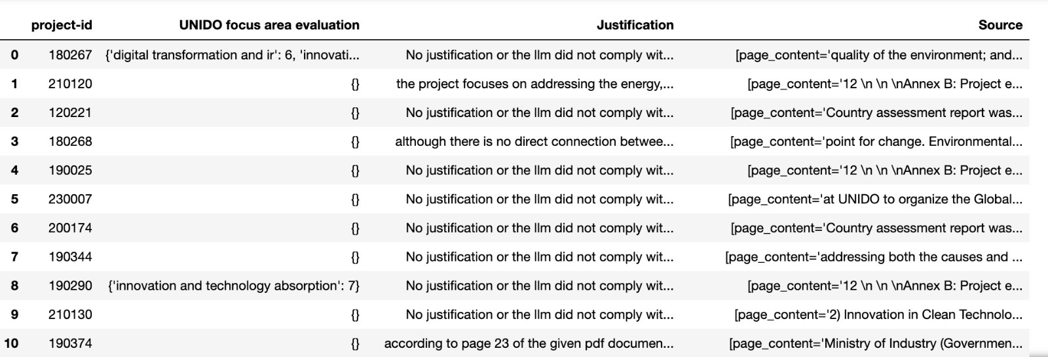
Prompt Outputs
Task 3: Project evaluation based on UNIDO Focus Areas

Slide 19

Combining Human Expertise
Multiple texts were manually examined and classified by us according to different
SDGs, UNIDO priorities, and focus areas of expertise:
This was used to test the effectiveness of LLM prompts when cross-examined
Prompts were then curated as per the performance
The method showed a noticeable improvement in prompt quality and results

Slide 20
Themes
Remember the messy drawer?
Wouldn't cleaning the mess be nicer? Like sorting the notes into clear piles.
Each pile represents a "topic" found within the documents. It helps discover major themes without having to read everything individually.

Slide 21
Themes
Topic modeling automatically reveals the underlying themes (topics) and patterns of documents that would otherwise be difficult to find within the sheer volume of data.
Furthermore:
It provides a systematic, data-driven approach to classification that reduces subjectivity and bias
Completely unsupervised
The themes are then shown as wordclouds

Slide 22

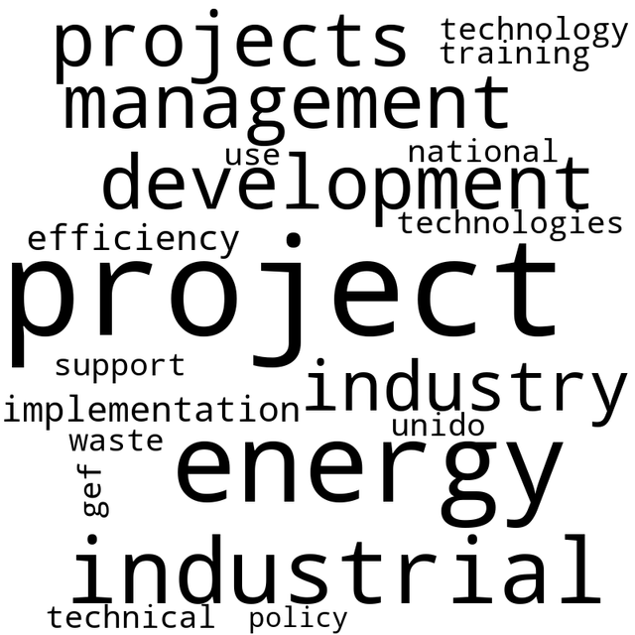

Wordclouds
Wordclouds of a few hand-picked topics

Slide 23
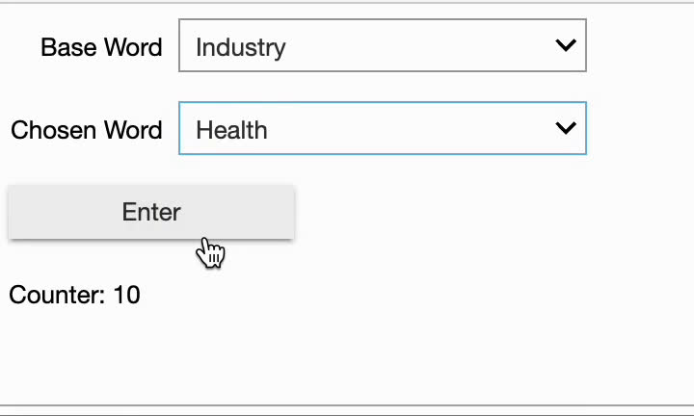
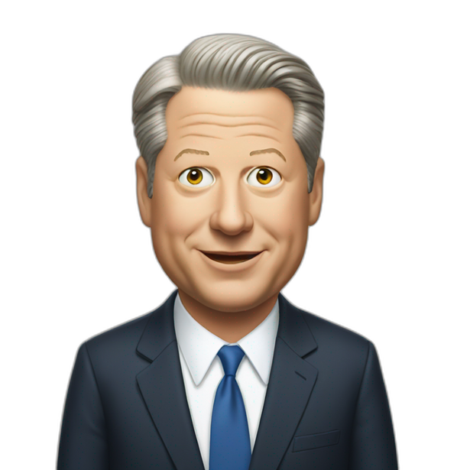
Bonus Challange
"AI-Gore"
Combine Words to generate SDGs
(details explained in code)

Slide 24
Impact
A reporting system that meets the expectations of the UN secretariat, donors, and the general public:
The use of automated classification eliminates time-consuming manual categorization of project documents
Enables fast reporting on project distributions across categories, aiding with strategic updates and resource allocation
The result is a structured and accessible project database that helps UNIDO staff focus on higher-value activities and displays the organization’s contribution to the Sustainable Development Goals

Slide 25
Limitations
Limited data: As mentioned before we used a smaller dataset for the analysis, which is beneficial for a short hackathon. However, the methodology is scalable.
Limited computation: Entire documents cannot be passed due to token usage restrictions and eventual loss of context/memory on LLM's part. Instead, chunks of documents are passed after extensive prompt engineering.
Human intervention: LLMs can still make errors, therefore a balanced approach between LLMs and humans is necessary. (see next page)

Slide 26
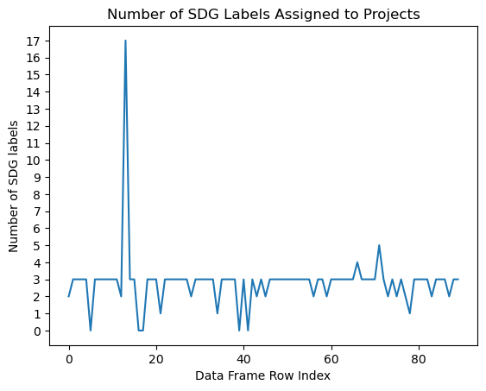
Limitations
The total number of SDG labels assigned to each project should be no more than 3
0 happens when the response does not have the form we expected
17 is ? This is why human supervision is still very much needed

Slide 27



Working in Tandem with AI

Slide 28
Future Perspctives
Scalability: the developed model could be used to help other UN agencies in their SDG reporting practices and facilitate an inter-sectoral collaboration and framework creation
Documentation: the project highlights the need for streamlined data upload and -analysis policy
Bespoke LLMs: creation of an in-house LLM model that is better suited to serve UNIDO’s needs

Slide 29

That’s a Wrap
We thank you for your attention
. . . to be continued on 19. March

